Slide 1
Bubble Bobble
Sabri Amer and Joshua Eckels – CSSE220
November 9, 2018

Slide 2
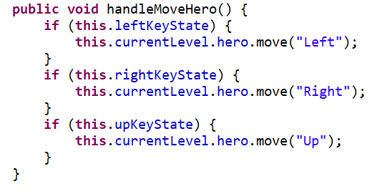
Enhanced Features
Smooth Movement
Monster/Bubble Interaction
Fruit Spawning
Level Constructor

Slide 3
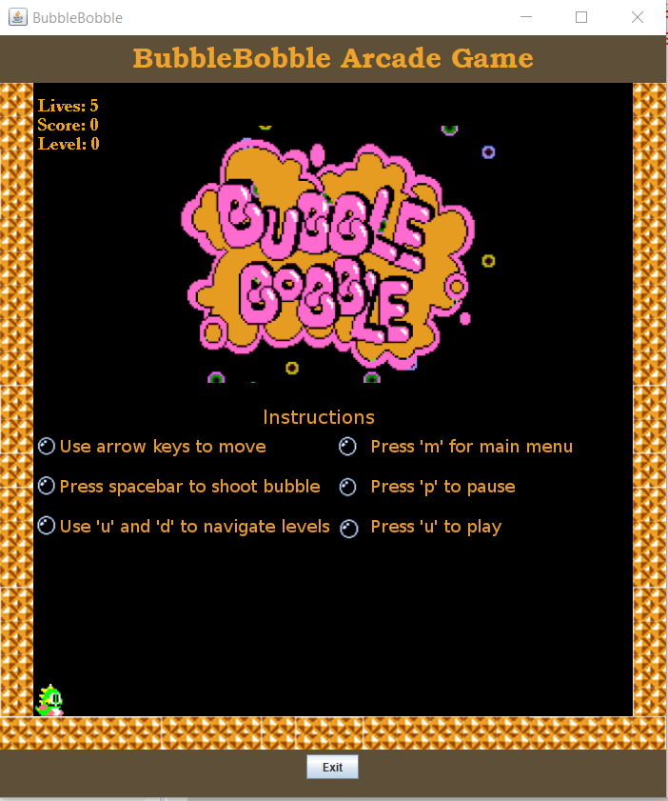
New Features
Sprites / Animations
Music
Loading Screens

Slide 4
Demo

Slide 5
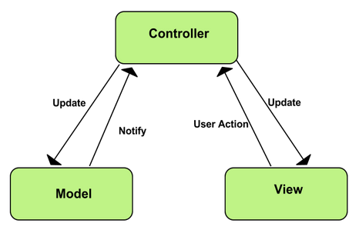
Overcoming Design Issues
Model-View-Controller

Slide 6
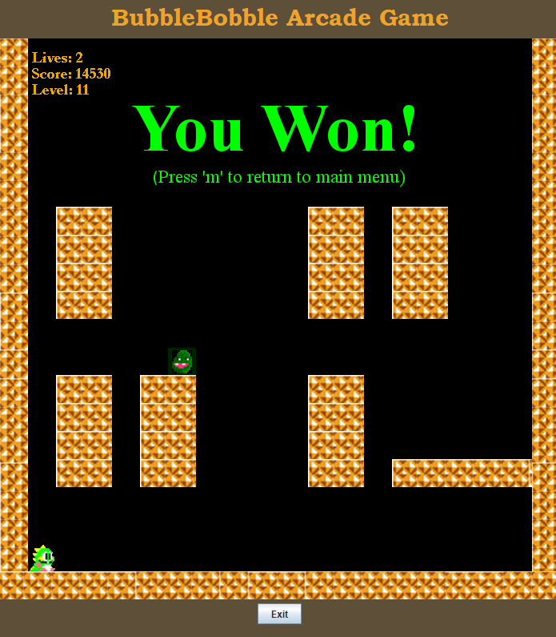
Questions

